Slide 1

Indices

Slide 2
Searching
Searching a file takes, on average, time proportional to ½ of the size of the file.
Which makes sense:
while (not found and not end of file)
read record
found = {record matches}
if end of file
throw exception
else
return record

Slide 3
Indices (or indexes)
Think about finding every instance of a word in a book. You would skim every page, taking notes of the page numbers where you find that word.
Or you could flip to the back of the book which has an index. Find the word (alphabetically) and the relevant page numbers are listed.

Slide 4
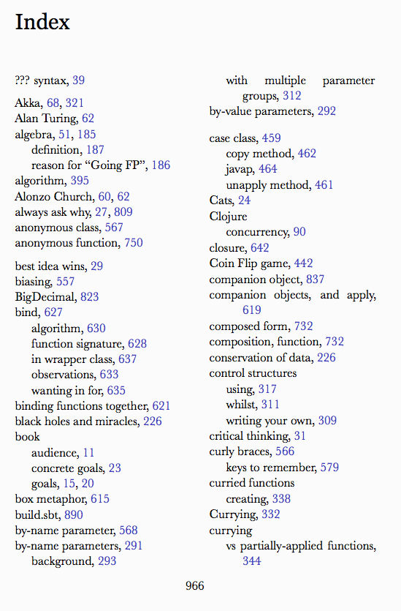
Indices
A database index is just like a book index – an entry points to a page where I can find that information.

Slide 5
ISAM indices
Often each index was a different file. As you can imagine, this led to a lot of issues. One classic example was older code that wasn’t aware of an index file would insert a record and the index would get out of sync.

Slide 6
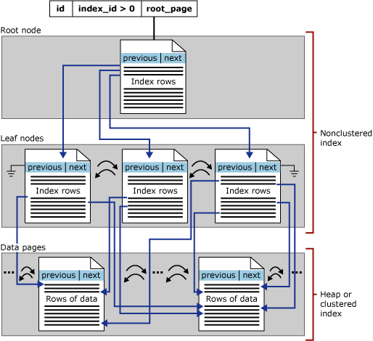
Indices are stored
An index is “just” another series of pages, like a table.
The Root node and leaf nodes are B-Trees.
The leaves point to the data pages.

Slide 7
Indices
Consider a row of data that is 500 bytes wide.
Now, consider that 4 bytes of that row is an integer.
We are looking for rows where the integer = 0.
If we have 100,000 rows in our table, how many bytes do we have to read to find our answer without indices?
100,000 X 500 ➔ 50,000,000 bytes – 50 megabytes. That’s not accounting for overhead (page headers, etc.)

Slide 8
Indices
Value | Page(s)
-5 | 22,35,77
-3 | 7,3
0 | 44,92,127
Consider, now, that we have an index on that integer. We store the integer (4 bytes) and the page number of the page that the row is stored on.
What’s the largest number of bytes we need to read for the index?
Let’s assume that all 100,000 rows have unique pages (worst case).
100,000 X (4 (value) + 4 (page) = 100,000 X 8 = 800,000 = 800K
That’s a 62.5 times improvement. Of course, now we have to go read the data page, so we read another 8,000 bytes…

Slide 9
B-Tree
If indices were just simple lists, that would be an enormous savings.
The good news is that they are not!
Indices are B-Trees, a data structure designed for O(log(n)) search. The interesting performance item to note is that the base on the log is what’s called blocking factor – how many records we can fit in one block/page. The smaller the contents of the data index, the better search will perform.

Slide 10
B-Tree works with pages of pointers
Non-Leaf nodes
Ptr 1 | Val 1 | Ptr 2 | Val 2 | Ptr 3 | Val 3 | Ptr 4 | Val 4 | Ptr 5
Leaf nodes
Ptr 1 | Val 1 | Ptr 2 | Val 2 | Ptr 3 | Val 3 | Ptr 4 | Val 4 | Next
Ptr 1 | Val 1 | Ptr 2 | Val 2 | Ptr 3 | Val 3 | Ptr 4 | Val 4 | Next

Slide 11
B-Tree works with pages of pointers
Non-Leaf nodes
 | 5 |  | 30 |  | 90 |  | 125
Leaf nodes
 | 5 |  | 12 |  | 17 |  | 19
 | 21 |  | 24 |  | 27

Slide 12
Working with B-Trees
Adding and deleting is a little tricky.
Changes could unbalance the tree. When this happens, entries are shifted to rebalance the tree.
Fortunately, the database does all of this work for you. You need only reap the benefits!
The key takeaway here is that indices have a maintenance cost. The more indices and the more updates (add, delete, update) on the table, the more the cost.

Slide 13
SQL to Create an Index
create nonclustered index NAME on TABLE(COLUMN1, COLUMN2, …)
This can take a while – it needs to read the entire table in to create the index.
Naming – I typically use IX_TableColumn1Column2

Slide 14
Fill Factor
Through trial and error, it has been found that there is a tradeoff with B-Trees. If you insist that every page of the index be completely filled before splitting, occasional inserts can become overly expensive (requiring a split). Setting the value too low, though, means too many pages of index to read to find anything.
SQL Server sets the server default to 100%. This is the most disk space efficient and tends to be OK, even if occasional updates are too expensive.

Slide 15
Clustered and Non-Clustered
A clustered index is an index that actually re-orders the data pages of the table. The data rows are stored on disk in order by the criteria of the index. Clearly, there can be only one clustered index per table. When the data page is read, it will have a high degree of correlation to the index.
A non-clustered index is an ancillary data structure – it just points at the data pages. A whole data page can need to be read for one record. There can be as many non-clustered indices on a table as you have disk space and tolerance for.

Slide 16
Multiple Criteria
Indices can have more than one criteria item. The index is ordered by the items in order. For example – if we have an index by last name, first name, you might see in the index:
Smith, Abby
Smith, Beth
Smith, John
Smithers, Mr.
Caution – this may or may not increase the speed of a search on first name only. Why?

Slide 17
Included columns
Consider a table of patient (first name, last name, room number).
What if I frequently need room number, too – is it worth reading the whole disk block for just that?
You can include data items that are not part of the ordering in the index.

Slide 18
Included Columns
Pros
Cons
Covers more queries
Faster for certain queries
Takes up more space in the index blocks
More likely to need to update the index (since there is more data)
As always, this is a tradeoff. Don’t go overboard with included columns.

Slide 19
Unique Indices
When creating an index, there is an option to make that index unique. This will cause any insert or update to fail if it would make the data row not unique with respect to that index.
create table #temp (firstname varchar(100), lastname varchar(100), age int);
create unique index ixTempFirstNameLastName on #temp(firstname, lastname) include (age)
insert into #temp values ('John','Smith',25);
insert into #temp values ('John','Smith',26); -- FAIL
insert into #temp values ('John','Smith',25); -- FAIL

Slide 20
Filtered Indices
Let’s change our patient a bit:
(LastName, FirstName, Age, Sex, IsPregnant)
If we want to find all of the pregnant people frequently, an index would be helpful. Do we need to index the males?
create table #temp (firstname varchar(100), lastname varchar(100), age int, sex char(1), isPregnant bit);
create nonclustered index ixTempSexIsPregnant on #temp
(sex, isPregnant)
where sex='F'
insert into #temp values ('John','Smith',25, 'M', 0);
insert into #temp values ('Jane','Smith',26, 'F', 0);
insert into #temp values ('Jess','Smith',26, 'F', 1);

Slide 21
Dropping Indices
DROP INDEX name ON table

Slide 22
Where are these indices stored?
Every system will be different.
In SQL Server, just like there are one or more files for data rows, there are also one or more files for indices.
Index files end with “.LDF”

Slide 23
Index Roundup
Indices are your primary tool to make your queries run fast.
Every index you add makes your inserts/updates/deletes slower and takes up disk space.
Clustered indices reorder the data; you only get one.
Non-clustered indices require an extra data read to get to the data from the index.

